Slide 1



Identification of Redundant Code Using AI
Jaypee University of Information Technology, Waknaghat - 173234 (India)
Major Project - I (18B19CI791) | AY 2024-25
Mid - Term Presentation
Group No.: 86
Team Member (s)
Piyush Joshi (211397)
Samriti Thakur (211150)
Prakhar Varshney (211327)
Supervisor (s)
Dr. Ramesh Narwal
Assistant Professor
CSE&IT
Ms. Seema Rani
Assistant Professor
CSE&IT

Slide 2
Outline
Introduction
Problem Statement
Objectives
Literature Review
Project Design and Architecture
Tools, Technologies and Languages
Dataset
Implementation (if any)
Results (if any)
Key Learnings
Work Plan till End-Term Evaluation
Project Plan
Work Contribution of Each Member
Supervisor (s) Remarks
References

Slide 3
Introduction
Code redundancy, or duplicated code (code clones), is a common issue in software development. It occurs when developers replicate code segments to save time or due to a lack of collaboration. While this may seem convenient initially, redundant code increases codebase size, complicates maintenance and can introduce inconsistencies or bugs when updating code.
The "Identification of Redundant Code Using AI" project aims to address this challenge by employing machine learning (ML) and natural language processing (NLP) techniques. Using advanced ML models, the project will automatically identify both exact and semantic code clones. By training on a dataset of labeled redundant code patterns, the system will be able to detect clones across large codebases, highlighting areas for refactoring and improving code quality.
This AI-based approach will streamline code maintenance, reduce duplication, and contribute to more efficient software development practices by producing cleaner more maintainable code.

Slide 4
Problem Statement
Code redundancy, or "code clones," occurs when identical or near-identical code segments are scattered across a codebase due to copy-pasting or unintentional duplication.
This leads to increased codebase size, makes maintenance more difficult, and introduces the risk of inconsistencies when changes are applied to only one instance of a clone.
Traditional methods, like manual reviews or text-based detection, often miss "near-miss" clones, where minor changes exist, or semantic clones, where the code behaves the same but looks different.
As codebases grow, manual identification and refactoring of redundant code becomes impractical, resulting in decreased efficiency and increased technical debt.
The need arises for an automated solution capable of detecting both exact and semantic code clones to help developers maintain cleaner, more efficient codebases.

Slide 5
Objectives
Automate Detection of Code Clones: Develop an AI-based system that can efficiently detect both exact and semantic code clones across large codebases, reducing the manual effort involved in identifying redundant code.
Improve Codebase Quality: Minimize code duplication and technical debt by identifying areas of the code that can be refactored, ensuring cleaner, more maintainable, and scalable software development.
Enhance Development Efficiency: Provide developers with actionable insights through automated clone detection reports, enabling quicker identification of redundant code and faster resolution during the development and maintenance processes.
Create a User-Friendly Tool for Code Clone Detection: To develop an intuitive and effective tool that integrates the AI model and allows users to easily scan their codebases for redundant code patterns.

Slide 6
Literature Review
S. No. | Author & Paper Title [Citation] | Journal/ Conference (Year) | Tools/ Techniques/ Dataset | Key Findings/ Results | Limitations/ Gaps Identified
1. | Zhenyu Xu, Victor S. Sheng. "Detecting AI-Generated Code Assignments Using Perplexity of Large Language Models"[20] | 2024 | Perplexity of Large Language Models, targeted perturbation, CodeBERT for mask- filling, unified scoring scheme. | The approach outperformed current detectors, raising the average AUC from 0.56 (GPTZero) to 0.87. | The method has not been tested across a diverse set of code generation models, which could introduce biases.
2. | Swaraj, A. and Kumar, S., 2023. Programming Language Identification in Stack Overflow Post Snippets with Regex Based Tf-Idf Vectorization over ANN.[4] | 2023 | The corpus consisted of a total 232,727 posts varying across 21 different programming languages | Random Forest outperformed other ML classifiers in grid search, NN even performed better than RF. | Prediction of programming languages in posts is relatively much challenging task.
3. | Morteza Zakeri - Nasrabadi, Saeed Parsa , Mohammad Ramezani, Chanchal Roy:”A systematic literature review on source code similarity measurement and clone detection.[13] | 2023 | Utilize methods like token-based, text-based, AST, and PDG for clone detection | Token-based methods efficiently detect Type-1 and Type-2 clones, but struggle with semantic clones (Type-4). | Token-based approaches are less effective for detecting Type-4 (semantic) clones.
4. | Tong Zhou, Ruiqin Tian, Rizwan A. Ashraf, Roberto Gioiosa, Vivek Sarkar. "ReACT: Redundancy- Aware Code Generation for Tensor Expressions[19] | 2022 | Redundancy-aware code generation, fusion algorithms, memory optimizations. | The ReACT system significantly reduces redundancies in code generation, improving performance | The approach may introduce more memory accesses under specific input conditions, particularly when loop iterations are very small.

Slide 7
Literature Review (cont…)
S. No. | Author & Paper Title [Citation] | Journal/ Conference (Year) | Tools/ Techniques/ Dataset | Key Findings/ Results | Limitations/ Gaps Identified
5. | Ajad Kumar, Rashmi Yadav and Kuldeep Kumar : “ A Systematic Review of Semantic Clone Detection Techniques in Software Systems “.[12] | 2021 | Program Dependency Graph (PDG): Used for detecting semantic clones by analyzing functional and data flow. | Program Dependency Graphs (PDGs) are highly effective for detecting semantic clones. | PDG-based approaches are time-consuming due to graph generation complexity.
6. | Feng, Zhangyin, et al. "Codebert: A pre-trained model for programming and natural languages." [1] | 2020 | CodeBERT is trained from Github code repositories in 6 programming languages. | CodeBERT performs better than previous pre-trained models on NL-PL probing. | The CodeBERT itself could be further improved by generation-related learning objectives.
7. | Dong Kwan Kim: “Enhancing code clone detection using control flow graphs “[11] | 2019 | Control Flow Graphs (CFGs) and deep learning for clone detection. | CFGs help capture both syntactic and semantic clones, making them more effective for deep learning-based clone detection. | The framework's performance can degrade with larger thresholds, especially for more semantically distant clones
8. | Kim, D.K., 2019. Enhancing code clone detection using control flow graphs. International Journal of Electrical & Computer Engineering.[3] | 2019 | BigCloneBench is used as the training dataset. | Deep learning algorithms can be considered to improve the weakness of the clone classifier using supervised learning. | In the case of semantic clone types such as MT3 and WT3/4 clones, the detection performance still needs to be improved

Slide 8
Literature Review (cont…)
S. No. | Author & Paper Title [Citation] | Journal/ Conference (Year) | Tools/ Techniques/ Dataset | Key Findings/ Results | Limitations/ Gaps Identified
9. | Ain, Q.U., Butt, W.H., Anwar, M.W., Azam, F. and Maqbool, B., 2019. A systematic review on code clone detection [6] | 2019 | Detection techniques are categorized into four classes. The textual, lexical, syntactic and semantic classes are discussed. | Detection techniques are categorized into four classes. The textual, lexical, syntactic and semantic classes are discussed. Software clones occur due to reasons such as code reuse by copying pre-existing fragments. | There is no clone detection technique which is perfect in terms of precision, recall, scalability, portability and robustness.
10. | Neha Saini, Sukhdip Singh, Suman: “Code Clones: Detection and Management “[10] | 2018 | Tokenization: Converts code to token sequences. | Code cloning helps reduce development time and costs. Clones can introduce bugs through propagation. | Hard to identify clones with minor modifications.
11. | Ragkhitwetsagul, C., Krinke, J. and Clark, D., 2018. A comparison of code similarity analysers. Empirical Software Engineering, 23, pp.2464-2519. [5] | 2018 | The generated data set with pervasive modifications used in this study has been created to be challenging for code similarity analysers. | Highly specialised source code similarity detection techniques and tools can perform better than more general textual similarity measures. | Highly specialised source code similarity detection techniques and tools can Similarity detection techniques and tools are very sensitive to their parameter settings.
12. | Yi Wang, Qixin Chen, Chongqing Kang, Qing Xia, and Min Luo. Sparse and Redundant Representation[14] | 2017 | Comparative analysis with k-means clustering, discrete wavelet transform (DWT). | The method effectively reduces data storage and communication costs while preserving high-resolution load information. | The sparsity constraint is uniform across all load profiles, and better results might be achieved with variable sparsity.

Slide 9
Literature Review (cont…)
S. No. | Author & Paper Title [Citation] | Journal/ Conference (Year) | Tools/ Techniques/ Dataset | Key Findings/ Results | Limitations/ Gaps Identified
13. | Martin White, Michele Tufano, Christopher Vendome, and Denys Poshyvanyk : “Deep Learning Code Fragments for Code Clone Detection”[9] | 2015 | Uses deep learning models: Recurrent Neural Networks (RtNN) and Recursive Neural Networks (RvNN). | Detected all clone types (I-IV). Achieved 93% precision. Feasible for real-world Java systems. | High computational costs. Large files slowed training.
14. | Svajlenko, J. and Roy, C.K., 2015, September. Evaluating clone detection tools with bigclonebench.[2] | 2015 | BigCloneBench contains both intra-project and inter-project clones of the four primary clone types. | The tools have strong recall for Type-1 and Type-2 clones, as well as Type-3 clones with high syntactical similarity. | The tools have weaker detection of clones with lower syntactical similarity.
15. | M. Zhang, "Detecting Redundant Operations with LLVM" GSoC 2015 Proposal[17] | 2015 | LLVM for static and dynamic instrumentation | Prototype implementation successfully detected performance bugs in known applications. | Large trace file sizes generated by the current method, requiring optimization
16. | Randy Smith and Susan Horwitz:”Detecting and Measuring Similarity in Code Clones”[8] | 2009 | Uses fingerprinting algorithms at the statement level. | Detects non-identical but similar code blocks Effective fingerprinting balances efficiency and accuracy for code similarity detection | O(n²) complexity when computing similarity for large datasets.

Slide 10
Literature Review (cont…)
S. No. | Author & Paper Title [Citation] | Journal/ Conference (Year) | Tools/ Techniques/ Dataset | Key Findings/ Results | Limitations/ Gaps Identified
17. | Z. A. Alzamil, "Application of Redundant Computation in Program Debugging"[16] | 2008 | Execution traces of sample programs for analysis | The detection of redundant computations aids in narrowing down the space of potential program defects and improves debugging efficiency. | Further optimization needed for detecting more types of memory leaks by refining dynamic memory dependency analysis.
18. | Van Rysselberghe, F. and Demeyer, S., 2003, September. Evaluating clone detection techniques.[7] | 2003 | The detection of code clones is a two phase process which consists of a transformation and a comparison phase. | No false matches are reported by both simple line matching and parameterized matching using suffix trees. | Future experiments should incorporate large and very-large programs into the set of cases.
19. | Andrian Marcus, Jonathan I. Maletic. "Identification of High-Level Concept Clones in Source Code"[18] | 2001 | Latent Semantic Indexing (LSI) for semantic similarity analysis, combined with clustering algorithms for clone detection. | The proposed method identifies high-level concept clones based on semantic similarities in source code documents. | Integration with structural-based clone detection methods could improve precision
20. | K. A. Kontogiannis, R. De Mori, E. Merlo, M. Galler, and M. Bernstein, "Pattern Matching for Clone and Concept Detection"[15] | 1996 | Dynamic programming algorithms | The dynamic programming method provided higher accuracy compared to direct metric comparison. | Limited ability to handle inexact matches and scale to very large systems.

Slide 11
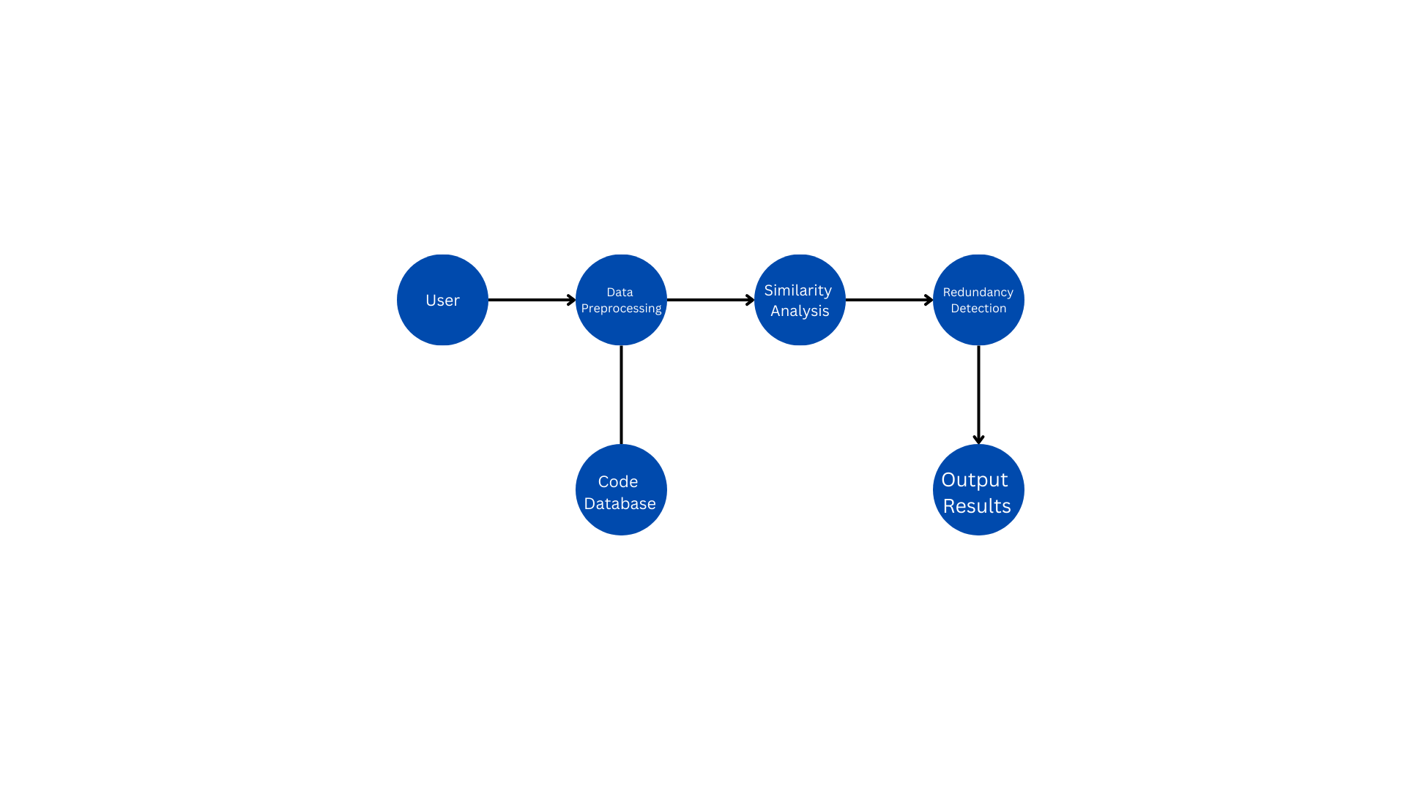
Project Design and Architecture
Data Flow Diagram (DFD) for Redundant Code detection System.
Figure 1
Redundant Code detection Flow chart

Slide 12
Project Design and Architecture (cont…)
User: The starting point, where the code or project is input into the system.
Data Preprocessing: This is the first step after user input. It's crucial for preparing the code for analysis, potentially involving tasks like tokenization, removing comments, or standardizing formatting.
Code Database: Connected to the Data Preprocessing step, this serves as a repository of code snippets or patterns to compare against.
Similarity Analysis: This step comes after preprocessing and uses the prepared data to analyze similarities between code segments. This is where AI techniques for code comparison would be applied.
Redundancy Detection: Based on the similarity analysis, this step identifies which code segments are likely redundant.
Output Results: The final step where the findings of redundant code are presented to the user.

Slide 13
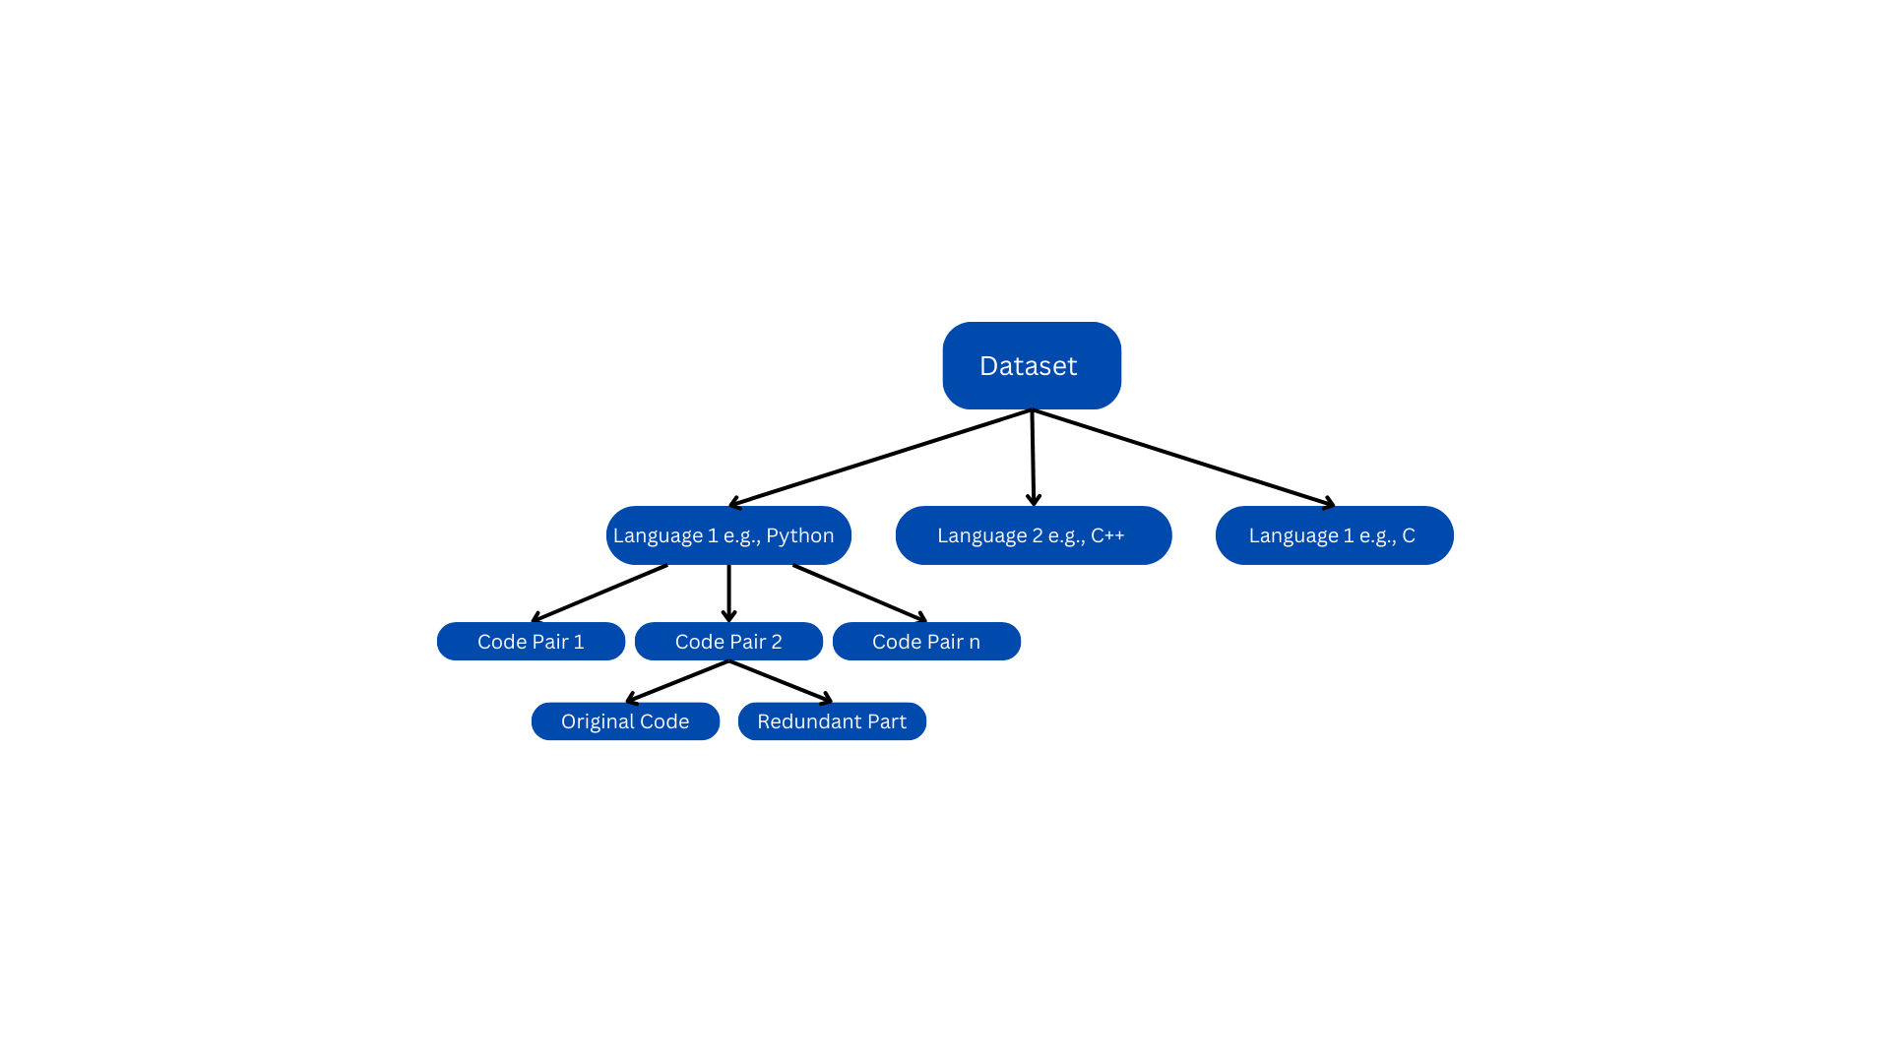
Project Design and Architecture (cont…)
Structural representation of the proposed dataset.
Figure 2
Proposed dataset.

Slide 14
Tools, Technologies and Languages
Languages and Technologies:
Python Version: 3.8 or higher
TensorFlow, PyTorch, Scikit-learn Version: 0.24, 3.5, 2.4 or higher
NLTK, SpaCy Version: 3.0, 4.0 or higher
Jupyter Notebook, Google Collab Version: Python 3.8
Integrated Development Environment, IDE (Visual Studio Code).

Slide 15
Tools, Technologies and Languages (cont…)
Hardware Resources:
Processor: intel i5 or higher
RAM: 16GB or Higher
256 GB SSD or Higher
Dataset:
The labelled dataset we will create will be designed to aid the machine learning model in detecting redundant code patterns, also known as code clones.

Slide 16
Dataset
1. Overview of the Dataset
The dataset we will create is designed to aid the machine learning model in detecting redundant code patterns, also known as code clones. The dataset will consist of a variety of source code snippets that exhibit both exact and near-duplicate code structures, as well as semantically similar code that may differ syntactically.
2. Types of Code Clones Included
The dataset will include the following types of code clones; Type-1 Clones (Exact Duplicates), Type-2 Clones (Syntactically Similar), Type-3 Clones (Semantically Similar).
3. Structure of the Dataset
Each record in the dataset will represent a code snippet and will be labeled to indicate whether it is a redundant code or an actual piece of code.
4. Programming Languages Covered
To ensure robustness, the dataset will cover a diverse set of programming languages commonly used in software development, such as:
Python, C, C+, Java.

Slide 17
Implementation (if any)
Implementation of Demo Code:
We built an initial prototype, implemented a simple demo using TF-IDF Vectorization and Cosine Similarity to detect redundant code. The key steps involved:
Dataset Creation: We created a small dataset of code snippet, including exact duplicates and similar code patterns.
Text Preprocessing: We applied tokenization techniques to preprocess the code snippets, which allowed us to convert the code into numerical form.
TF-IDF Vectorization: By applying TF-IDF, we converted the tokenized code into vectors, capturing the importance of each term in the code snippets.
Cosine Similarity Calculation: We then computed cosine similarity between code vectors to identify redundant code. A similarity threshold (0.9) was set to detect potential clones.
We also identified areas for improvement, such as using more advanced tokenization methods or incorporating semantic analysis for better detection of near-miss and semantic clones, which we will be working upon in upcoming days.

Slide 18
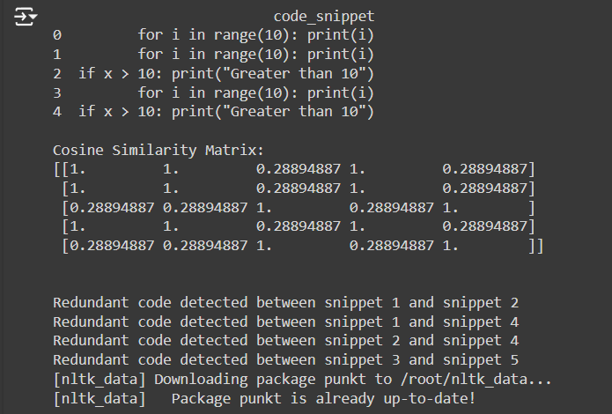
Results (if any)
Outputs of our initial project demo looked like this:

Slide 19
Key Learnings
Understanding Code Clones: Gained insights into exact and semantic code clones and their effects on software maintenance.
Machine Learning Application: Learned how deep learning and NLP techniques can be applied for detecting code redundancy.
Importance of Data Preprocessing: Recognized the crucial role of preprocessing steps like normalization and AST generation in enhancing detection accuracy.
Impact on Software Quality :Realized how reducing code redundancy directly contributes to improving overall software quality and maintainability.

Slide 20
Work Plan till End-Term Evaluation
Dataset Preparation: Collect and preprocess the dataset by cleaning code samples and generating Abstract Syntax Trees (ASTs).
Model Selection and Experimentation Objective: Select the appropriate machine learning model for clone detection and start preprocessing the data.
Initial Testing: Conduct preliminary tests on a sample dataset to evaluate the model’s performance in identifying code clones.

Slide 21
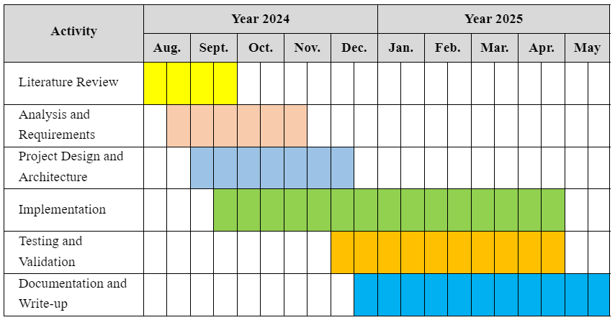
Project Plan

Slide 22
Work Contribution of Each Member
S. No. | Roll No. | Work Done | Work Contribution (%)
1. | 211397 | Literature research on existing methods for code clone detection. Problem statement understanding and research on dataset development. Worked on preparing the presentation for mid-term evaluation. | 35%
2. | 211150 | Literature Review and analysis. Analyzing project statement and research on selecting appropriate models. Worked on preparing for the mid-term evaluation and presentation. | 35%
3. | 211327 | Literature Review and analysis. Analyzed project statement and research on dataset development. Worked on preparing the presentation for mid-term evaluation. | 30%

Slide 23
Supervisor Remarks
S. No. | Week No. & Date (dd/mm/yy) | Remarks (as mentioned in the weekly log) | Incorporated (Yes/No)
1. | 1 (31/08/24) | Analyse and clarify the problem statement. Identify the models to be used. Implement a basic prototype or demo. | Yes (Week No. 1)
2. | 2 (13/09/24) | Satisfactory. | Yes (Week No. 2)
3. | 3 (18/09/24) | Satisfactory. | Yes (Week No. 3)
4. | 4 (27/09/24) | Prepare for the mid-term evaluation. Make appropriate changes in the presentation. | Yes (Week No. 4)
5. | 5 (dd/mm/yy) | Remark 1 Remark 2 Remark 3 | Yes/No (Week No.)
6. | 6 (dd/mm/yy) | Remark 1 Remark 2 Remark 3 | Yes/No (Week No.)

Slide 24
References
[1] Feng, Z., Guo, D., Tang, D., Duan, N., Feng, X., Gong, M., Shou, L., Qin, B., Liu, T., Jiang, D. and Zhou, M., 2020. Codebert: A pre-trained model for programming and natural languages. arXiv preprint arXiv:2002.08155.
[2] Svajlenko, J. and Roy, C.K., 2015, September. Evaluating clone detection tools with bigclonebench. In 2015 IEEE international conference on software maintenance and evolution (ICSME) (pp. 131-140). IEEE.
[3] Kim, D.K., 2019. Enhancing code clone detection using control flow graphs. International Journal of Electrical & Computer Engineering (2088-8708), 9(5).
[4] Swaraj, A. and Kumar, S., 2023. Programming Language Identification in Stack Overflow Post Snippets with Regex Based Tf-Idf Vectorization over ANN. In ENASE (pp. 648-655).
[5] Ragkhitwetsagul, C., Krinke, J. and Clark, D., 2018. A comparison of code similarity analysers. Empirical Software Engineering, 23, pp.2464-2519.
[6] Ain, Q.U., Butt, W.H., Anwar, M.W., Azam, F. and Maqbool, B., 2019. A systematic review on code clone detection. IEEE access, 7, pp.86121-86144.
[7] Van Rysselberghe, F. and Demeyer, S., 2003, September. Evaluating clone detection techniques. In Proc. Int’l Workshop on Evolution of Large-scale Industrial Software Applications (ELISA) (pp. 25-36).

Slide 25
References (cont…)
[8] R. Smith and S. Horwitz, “Detecting and measuring similarity in code clones,” *ResearchGate*, 2009.
[9] Martin White, Michele Tufano, Christopher Vendome, and Denys Poshyvanyk : “Deep Learning Code Fragments for Code Clone Detection”,2015.
[10] Neha Saini, Sukhdip Singh, Suman : Code Clones: Detection and Management . In International Conference on Computational Intelligence and Data Science (ICCIDS 2018) .
[11] Dong Kwan Kim :Enhancing code clone detection using control flow graphs. In International Journal of Electrical and Computer Engineering (IJECE) Vol. 9, No. 5, October 2019, pp. 3804~3812 ISSN: 2088-8708, DOI: 10.11591/ijece.v9i5.pp3804-3812 .
[12] Ajad Kumar, Rashmi Yadav and Kuldeep Kumar: A Systematic Review of Semantic Clone Detection Techniques in Software Systems. IOP Conf. Series: Materials Science and Engineering 1022 (2021) 012074.
[13] Morteza Zakeri-Nasrabadi, Saeed Parsa , Mohammad Ramezani, Chanchal Roy, Masoud Ekhtiarzadeh :A systematic literature review on source code similarity measurement and clone detection: Techniques ,applications ,and challenges.The Journal of Systems & Software 204 (2023) 111796.

Slide 26
References (cont…)
[14] IEEE Transactions on Power Systems, vol. 32, no. 3, pp. 2142-2151, May 2017.
[15] K. A. Kontogiannis, R. De Mori, E. Merlo, M. Galler, and M. Bernstein, "Pattern Matching for Clone and Concept Detection," Automated Software Engineering, vol. 3, pp. 77–108, 1996
[16] Z. A. Alzamil, "Application of Redundant Computation in Program Debugging," Journal of Systems and Software, vol. 81, no. 11, pp. 2024–2033, Nov. 2008.
[17] M. Zhang, "Detecting Redundant Operations with LLVM," GSoC 2015 Proposal, unpublished, 2015.
[18] Marcus, A., & Maletic, J. I. (2001). Identification of High-Level Concept Clones in Source Code. Proceedings of the International Conference on Automated Software Engineering (ASE '01), pp. 46-53.
[19] Zhou, T., Tian, R., Ashraf, R. A., Gioiosa, R., Kestor, G., & Sarkar, V. (2022). ReACT: Redundancy-Aware Code Generation for Tensor Expressions. Proceedings of the International Conference on Parallel Architectures and Compilation Techniques (PACT '22).
[20] Xu, Z., & Sheng, V. S. (2024). Detecting AI-Generated Code Assignments Using Perplexity of Large Language Models. Proceedings of the AAAI Conference on Artificial Intelligence, 38(21), 23155-23162.

Slide 27
Thanks.

